Slide 1
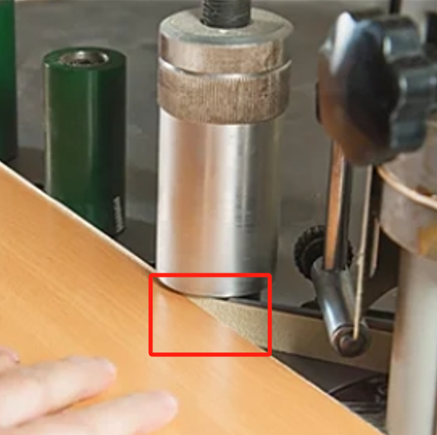
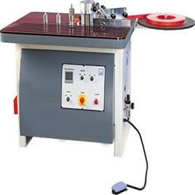
Application Products and Equipment
Edge banding not only enhances the aesthetic appeal of products but also effectively seals harmful substances within the boards, playing an environmentally - friendly role.
Applicable Edge - banding Substrates: Particleboard, medium - density fiberboard, solid wood.
Applicable Edge - banding Materials: PVC edge - banding, wood veneer, and melamine - based edge - banding.
The "UNISN" edge - banding hot - melt adhesive is mainly used in edge - banding machines. The edge - banding machine liquefies the hot - melt adhesive and applies it to the board to be edge - banded. Then, the board is pressed together with the edge - banding material. After the liquid hot - melt adhesive cools and solidifies, the board and the edge - banding material are bonded together.

Slide 2
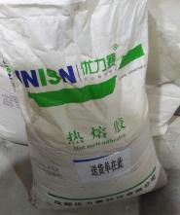
Why Choose UNISN Hot - melt Adhesive
Fine and Uniform Glue Lines: It can form a neat and smooth glue layer on the edge of the wooden board, enhancing the product's grade.
Good Fluidity: It can be quickly and evenly coated on the surface of the adherend and fit well, ensuring the integrity of the bond.
High Peel Strength: It creates a strong adhesive force between the hot - melt adhesive, the wooden board, and the edge - banding strip, effectively withstanding various external forces such as pulling, collision, and friction that may occur during daily use.
Excellent High and Low - Temperature Resistance: In high - temperature environments, the hot - melt adhesive will not soften or flow due to heat, causing the edge - banding strip to shift or the glue layer to lose its adhesion. In low - temperature environments, it will not become brittle, resulting in glue - layer cracking or edge - banding strip detachment.
Environmentally Friendly and Harmless: It is made from environmentally friendly raw materials, causing no pollution to human health and the environment. It can be widely used in fields with high environmental requirements.

Slide 3
Usage Methods and Precautions
Low - Temperature Edge - banding Hot - melt Adhesive: Mainly used in manual edge - banding machines. The recommended operating temperature range is 130 - 160°C.
Medium - Temperature Edge - banding Hot - melt Adhesive: Suitable for manual or semi - automatic edge - banding machines. The operating temperature is set between 160 - 190°C.
High - Temperature Edge - banding Hot - melt Adhesive: Primarily used in fully automatic edge - banding machines. The operating temperature range is 180 - 200°C.
In addition, the following points should be noted:
When the edge - banding machine is not in operation, lower the temperature of the glue tank to about 150°C to prevent the hot - melt adhesive from carbonizing and to facilitate subsequent heating.
Regularly clean the glue tank and the glue - applying roller. Excessive carbonized substances around the glue tank and residues on the glue - applying roller will reduce the performance of the heating system and the glue - supply system.
Keep the temperature of the hot - melt glue tank within the recommended operating temperature range.
Avoid contaminating the boards and edge - banding materials.
Ensure that the moisture content of the wood is around 8% - 10%.

Slide 4
FAQ
Production Anomaly | Cause Analysis | Solutions
Insufficient Initial Adhesion Strength | Poor substrate quality | Select a hot - melt adhesive with a higher viscosity
 | Too high viscosity of the hot - melt adhesive | Choose a product with a lower viscosity
Insufficient Bonding Strength | Too little glue application | Adjust the settings of the edge - banding machine
 | Inappropriate edge - banding machine temperature | Adjust the temperature of the edge - banding machine
 | Too fast feeding speed of the edge - banding machine | Select a hot - melt adhesive with a shorter open time
 | Too low edge - banding environment temperature | Pre - heat the boards and edge - banding strips
Obvious Glue Lines | Inclined coating surface | Maintain a 90 - degree angle
Difficult Edge - banding | Poor back - coating quality of the edge - banding strip | Replace the product

Slide 5
Thank You for Your Attention!
Sichuan UNISN New Material Technology Co., Ltd.
Office Address: Room 806, Building 5, China Railway West City Business District, Qingyang District, Chengdu,
Sichuan Province,
China
Tel: +86 028-81726336 Fax: +86 028-81766336
Mobile: +86 138 8208 4297 Email: unisn@foxmail.com

